Slide 1
String Matching Algorithm
Rabin Karp Algorithm

Slide 2
What Rabin Karp Algorithm is?
It is String matching algorithm
It is another application of Hashing
It is widely used for multiple pattern search.

Slide 3
Concept of Rabin Karp Algorithm
The Rabin-Karp string searching algorithm calculates a hash value for the pattern, and for each M-character subsequence of text to be compared
If the hash values are unequal, the algorithm will calculate the hash value for next M-character sequence
If the hash values are equal, the algorithm will compare the pattern and the M-character sequence
In this way, there is only one comparison per text subsequence, and character matching is only needed when hash values match

Slide 4
Consider an M-character sequence as an M-digit number in base b, where b is the number of letters in the alphabet
The text subsequence t[i .. i+M-1] is mapped to the number
x(i) = t[i]*b^M-1+ t[i+1]*b^M-2+...+ t[i+M-1]
 Furthermore, given x(i) we can compute x(i+1) for the next subsequence t[i+1 .. i+M] in constant time, as follows:
x(i+1) = t[i+1]∗b^M-1+ t[i+2]*b^M-2+...+ t[i+M]
x(i+1) = x(i)*b (Shift left one digit)
- t[i]*b^M (Subtract leftmost digit) + t[i+M]Add new rightmost digit
In this way, we never explicitly compute a new value
We simply adjust the existing value as we move over one character.
If M is large, then the resulting value (b^M) will be enormous. For this reason, we hash the value by taking it mod a prime number q

Slide 5
Rabin Karp Algorithm
1. n = Length[T],m = Length[P]
2. h = d^m-1 mod q
3. p = 0,to = 0
4. for i= 0 to m
5. do p = (d*p + P[i]) mod q
6. to = (d*to + T[i]) mod q
7. For s =0 to n-m
8. do if p=ts
9. then if P[1..m] ==T[s+1..s+m]
10. then “Pattern founds at shift “ s
11. if s<n-m
12. then ts+1=(d(ts-T[s+1])h+T[s+m+1]

Slide 6
Running Time Of R.K. Algorithm
 Running time for Rabin Karp algorithm is O((n-m+1)m) in the worst case, since the Rabin Karp algorithm explicitly verifies every valid shift
Applications
Text processing
Bioinformatics
Compression

Slide 7
Like the Naive Algorithm, the Rabin-Karp algorithm also slides the pattern one by one
But unlike the Naive algorithm, the Rabin Karp algorithm matches the hash value of the pattern with the hash value of the current substring of text, and if the hash values match then only it starts matching individual characters
So, Rabin Karp algorithm needs to calculate hash values for the following strings
Pattern itself
All the substrings of the text of length m
Since we need to efficiently calculate hash values for all the substrings of size m of text, we must have a hash function that has the following property:
Hash at the next shift must be efficiently computable from the current hash value and next character in text or we can say hash(txt[s+1 .. s+m]) must be efficiently computable from hash(txt[s .. s+m-1]) and txt[s+m] i.e., hash(txt[s+1 .. s+m]) = rehash(txt[s+m], hash(txt[s .. s+m-1])) and
Rehash must be O(1) operation.

Slide 8
The hash function suggested by Rabin and Karp calculates an integer value. The integer value for a string is the numeric value of a string.
For example, If all possible characters are from 1 to 10, the numeric value of “122” will be 122.
The number of possible characters is higher than 10 (256 in general) and the pattern length can be large
So the numeric values cannot be practically stored as an integer
Therefore, the numeric value is calculated using modular arithmetic to make sure that the hash values can be stored in an integer variable (can fit in memory words)
To do rehashing, we need to take off the most significant digit and add the new least significant digit for in hash value

Slide 9
Rehashing is done using the following formula:
hash( txt[s+1 .. s+m] ) = ( d ( hash( txt[s .. s+m-1]) – txt[s]*h ) + txt[s + m] ) mod q
hash( txt[s .. s+m-1] ) : Hash value at shift s
hash( txt[s+1 .. s+m] ) : Hash value at next shift (or shift s+1)
d: Number of characters in the alphabet
q: A prime number
h: d(m-1)

Slide 10
Example: pattern length is 3 and string is “23456”
You compute the value of the first window (which is “234”) as 234.
How will you compute the value of the next window “345”? You will do (234 – 2*100)*10 + 5 and get 345
Follow the steps mentioned here to implement the idea:
Initially calculate the hash value of the pattern.
Start iterating from the starting of the string:
Calculate the hash value of the current substring having length m.
If the hash value of the current substring and the pattern are same check if the substring is same as the pattern.
If they are same, store the starting index as a valid answer. Otherwise, continue for the next substrings.
Return the starting indices as the required answer.

Slide 11
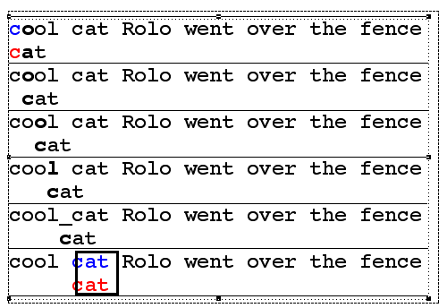
Brute Force Pseudo-Code
Here’s the pseudo-code
do if (text letter == pattern letter)
compare next letter of pattern to next
letter of text
else move pattern down text by one letter
while (entire pattern found or end of text)

Slide 12
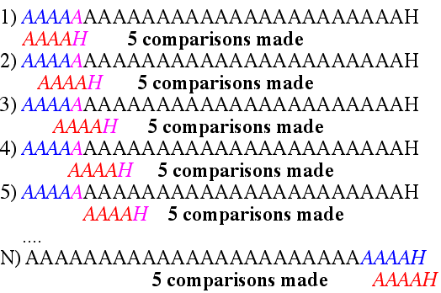
Brute Force-Complexity
Given a pattern M characters in length, and a text N characters in length...
Worst case: compares pattern to each substring of text of length M. For example, M=5.
This kind of case can occur for image data.
Total number of comparisons: M (N-M+1)
Worst case time complexity: O(MN)

Slide 13

Brute Force-Complexity(cont.)
Given a pattern M characters in length, and a text N characters in length...
Best case if pattern found: Finds pattern in first M positions of text. For example, M=5.
Total number of comparisons: M
Best case time complexity: O(M)

Slide 14
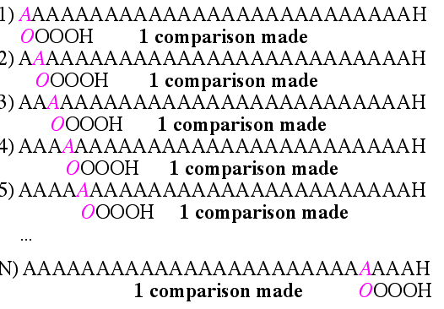
Brute Force-Complexity(cont.)
Given a pattern M characters in length, and a text N characters in length...
Best case if pattern not found: Always mismatch on first character. For example, M=5.
Total number of comparisons: N
Best case time complexity: O(N)

Slide 15
Rabin-Karp
The Rabin-Karp string searching algorithm calculates a hash value for the pattern, and for each M-character subsequence of text to be compared.
If the hash values are unequal, the algorithm will calculate the hash value for next M-character sequence.
If the hash values are equal, the algorithm will do a Brute Force comparison between the pattern and the M-character sequence.
In this way, there is only one comparison per text subsequence, and Brute Force is only needed when hash values match.

Slide 16
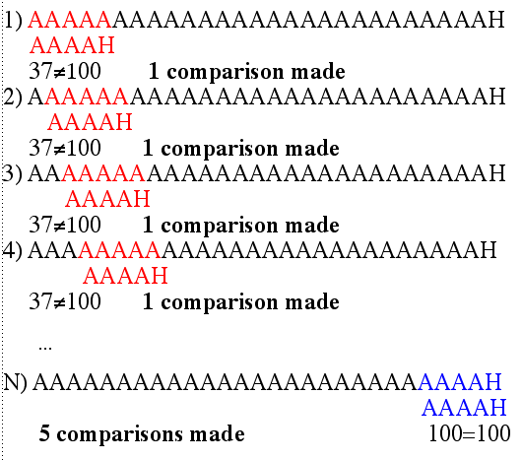
Rabin-Karp Example
Hash value of “AAAAA” is 37
Hash value of “AAAAH” is 100

Slide 17
Rabin-Karp Algorithm
pattern is M characters long
hash_p=hash value of pattern
hash_t=hash value of first M letters in body of text
do
if (hash_p == hash_t)
brute force comparison of pattern and selected section of text
hash_t= hash value of next section of text, one character over
while (end of text)

Slide 18

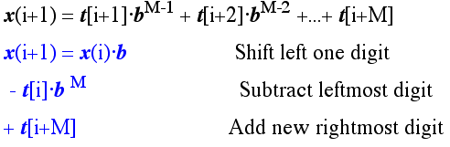
Hash Function
Let b be the number of letters in the alphabet. The text subsequence t[i .. i+M-1] is mapped to the number
Furthermore, given x(i) we can compute x(i+1) for the next subsequence t[i+1 .. i+M] in constant time, as follows:
In this way, we never explicitly compute a new value. We
simply adjust the existing value as we move over one
character.

Slide 19
Rabin-Karp Math Example
Let’s say that our alphabet consists of 10 letters.
our alphabet = a, b, c, d, e, f, g, h, i, j
Let’s say that “a” corresponds to 1, “b” corresponds to 2 and so on.
The hash value for string “cah” would be ...
3*100 + 1*10 + 8*1 = 318

Slide 20
Rabin-Karp Mods
If M is large, then the resulting value (~b^{M}) will be enormous. For this reason, we hash the value by taking it mod a prime number q.
The mod function is particularly useful in this case due to several of its inherent properties:
[(x mod q) + (y mod q)] mod q = (x+y) mod q
(x mod q) mod q = x mod q
For these reasons:
h(i)=((t[i] b^{M-1} mod q) +(t[i+1] b^{M-2} mod q) + … +(t[i+M-1] mod q))mod q
h(i+1) =( h(i) b mod q
Shift left one digit
-t[i] b^{M} mod q
Subtract leftmost digit
+t[i+M] mod q )
Add new rightmost digit
mod q

Slide 21
Rabin-Karp Complexity
If a sufficiently large prime number is used for the hash function, the hashed values of two different patterns will usually be distinct.
If this is the case, searching takes O(N) time, where N is the number of characters in the larger body of text.
It is always possible to construct a scenario with a worst case complexity of O(MN). This, however, is likely to happen only if the prime number used for hashing is small.

